Slide 1



NeCTAR eResearch Tools
Cloud-based Bioinformatics Tools Project
Steering Committee Meeting 27 March 2013

Slide 2
Agenda
Action Items from Previous Meeting
Project Report
Progress against milestones
Finance summary
Project Risks and Issues
External Dependencies
Other Business
Approach going forward

Slide 3
Action items from last meeting
Action Item | Status
Paul White to investigate starting a BLOG for the project | Completed. Expanded, and project documents updated on NeCTAR page. Will update at least monthly
Nik Zeps and Paul White to submit a proposal to COSA requesting Project Officer time for early 2013 to attempt to identify what systems are being used by cancer biobanks in Australia. | ?
Paul White to send targeted communications to potential candidates for the tools. | It has been agreed that there is an initial need to concentrate the limited staffing on completing the current tasks and working with current groups before taking on work we are understaffed to handle.
Paul White to develop a timeline for broader user access to the tools. | Travis will take these?
Paul White to scan and distribute the completed UAT documents to the Steering Committee members as they are signed off. | Travis will take these?

Slide 4
Project Report - Milestones
Funding Milestone 1 – Achieved and Payment received
Funding Milestone 2 – Achieved and payment received
Supported Tools and Processes;
Integration with the AAF authentication services;
Deployed in the AAF Test Environment
Have finally received permission to use UWA’s AAF Account to move this into Production at with no ongoing charges
Funding Milestone 3 (scheduled 31st August)
Integrated invoicing and billing module
Completed and Signed off
Initial Production Research Cloud Deployment
Code base has been approved in test environment
WARTN production data migrated to Production server and undergoing acceptance testing by SJOG staff. Intended to be complete for upcoming NeCTAR report.

Slide 5
Project Report - Milestones
Funding Milestone 4 (Scheduled 30th November)
A data extraction for analysis module;
75% Complete – expect completion of first production release by 30th April, 2013.
A pedigree (family) data management and visualisation module;
20% Complete – expect completion by 10th May, 2013
Funding Milestone 5 (Scheduled 1st March 2013)
Enhanced reporting functionality;
50% Complete
Registry Management functionality for managing participant registries, such as the Australian Twin Registry
100% Complete (subject to user acceptance) – was required to support SJOG data migration.
A Genotypic Data management module
Have commenced discussions with GVL participants to determine best way to implement this

Slide 6
Project Report - Financial
Total project budget: $614,490
Total NeCTAR contribution: $289,000 (note revised down from initial request)
Total co-investment: $324,965
Funds received to-date $104,000
See attched NeCTAR financial report
A restructuring of funding milestones was made due to staffing and dependencies, we are awaiting the response, but all seems to be in order. For now we are reporting against existing milestones.

Slide 7
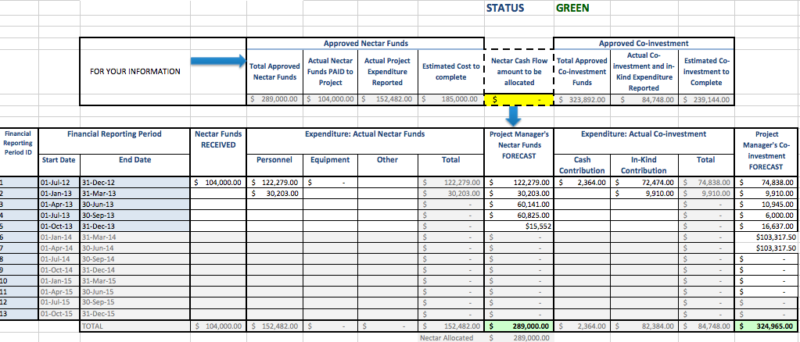
NeCTAR Financial Reporting

Slide 8
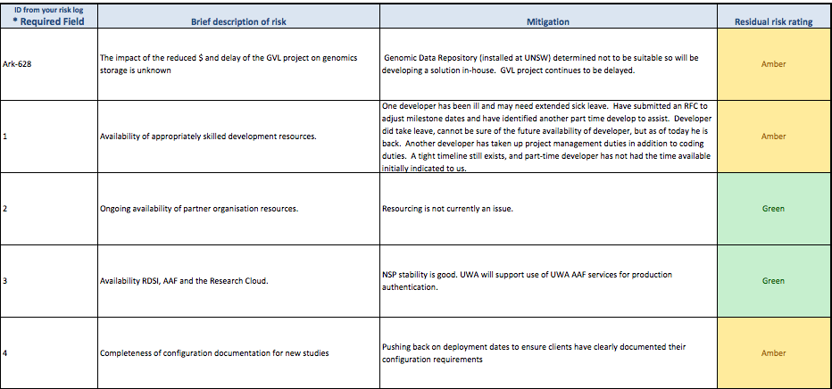
NeCTAR Reporting – Risks

Slide 9
Other Business
SPArk Grant under way to facilitate super computer analysis routines from within the ARK.
Date for next meeting – propose mid June, 2013.
Updaqte via email next report milestone
I have proposed some operational improvements going forward;

Slide 10
Approach Going Forward
Transparency – all projects and subcomponents will be estimated and tracked on Atlassian/JIRA.
All participants and committee members are welcome to view progress and make feature requests
All coders will be required to update these estimates each time they advance (or regress) in their goals/tasks
For those seeking a less proactive view, a manually produced summary email could be sent on some regular interval (monthly or fortnightly) if required.
Hopefully part of a fundamental philosophy/ethos: dealing with issues upfront and openly to get the best outcome

Slide 11
Approach Going Forward
Prioritization – this project is already at or beyond full capacity. Feature requests are welcomed via the JIRA system. However, everything will need to be prioritized.
If we keep a good track on priorities we don’t see opportunity cost of small superficial changes add up at the cost of larger key functionality missing deadlines.
Direct access to developers is not a recommended practice if we want priorities clear and time well managed.

Slide 12
Approach Going Forward
Knowledge Sharing and Documentation
We will try to ensure there is not one human point of failure for the system.
The system should be able to be managed by anyone with access to the documentation.
We are not there yet, but are putting these processes in place.
I also see a clear need to establish adequate User Documentation and training. Ideally we would like to try to establish a community of users also to share knowledge.

